Slide 1


IDB – Generative AI: Chatbot & LLM Proposal
Emergent Tech IT Consultant (Applicant) : Roger De Four

Slide 2
Project : Development of a Chatbot & LLM Software application
Development of an app that involves use of a chatbot coupled with an LLM (Large Language Model) backend, and which possesses the capability of answering questions, from a database containing more than 5000 documents/records.
The chatbot is expected to possess multi-lingual capabilities for three(3) languages.

Slide 3
Introduction

Slide 4
Large Language Model
Suitability for this problem domain
Content localization. Advanced chatbots can accommodate customers worldwide, as most come with multilingual capabilities.
Deep customer insights. With modern chatbots, businesses get streamlined access to client preferences and buying habits.
Around-the-clock service. Businesses invest in these products to answer questions and provide information outside regular hours
Cost efficiency. Using LLM-based chatbots lets businesses save up to 30% on customer support expenses.
An LLM is a type of AI, that can recognise and generate large volume of text. Its underlying technologies includes machine learning(ML) : neural networks – known as a “transformer model”
The most notable use case is in generative AI (GAI)

Slide 5
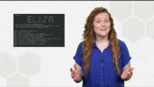
Large Language Model
Suitability for this problem domain
Content localization. Advanced chatbots can accommodate customers worldwide, as most come with multilingual capabilities. This provides an affordable and effective way to expand and maintain a global client base.
Deep customer insights. With modern chatbots, businesses get streamlined access to client preferences and buying habits. This information can improve marketing strategies, customer experience, and product development.
Around-the-clock service. Businesses invest in these products to answer questions and provide information outside regular hours. This approach increases customer loyalty, drives sales, and establishes companies as reliable and helpful.
Cost efficiency. Using LLM-based chatbots lets businesses save up to 30% on customer support expenses. These products handle tasks that previously required the work of live agents and experts, significantly reducing their staff.
An LLM is a type of AI, that can recognise and generate large volume of text. Its underlying technologies includes machine learning(ML) : neural networks – known as a “transformer model”
The most notable use case is in generative AI (GAI)

Slide 6

Generative AI (gAI)
GAI – a form of Artificial Intelligence (AI) whereby the computer program dynamically produces content (text, audio, computer code, etc) in response to “prompts” by an end-user, via a UI (User Interface).
Chatbots
A chatbot is a software or computer program that simulates human conversation or "chatter" through text or voice interactions.
Notes:
)Chatbots – are highly suitable for GAI
Examples of real-world LLMs include ChatGPT (from OpenAI), Bard (Google), Llama (Meta), and Bing Chat (Microsoft). GitHub's Copilot is another example, but for coding instead of natural human language.

Slide 7
System Architecture

Slide 8
Definitions
Unified modelling Language – UML 2.x will be used to illustrates a proposed solution for Chatbot/LLM .
UML diagrams used for proposal
Component Diagram - depicts how parts of a system are used to form larger whole.
Use Case – How the system is to be used by stakeholder interacting with it.
Other relevant terminology:
RWD (Responsive Web Design) – CSS formatting allows web page to fit onto various screen sizes.
PWA (Progressive Web Apps ) – used core web technologies, but gives platform specific technological solution.

Slide 9
Other relevant terminology:
RWD (Responsive Web Design) – this is a styling format used in CSS (Cascading Style Sheet, that enables the web page to fit onto screen sizes of various dimensions
PWA (Progressive Web Apps ) – used core web technologies as per a Web site, but gives the feeling of a platform specific technological solution.

Slide 10
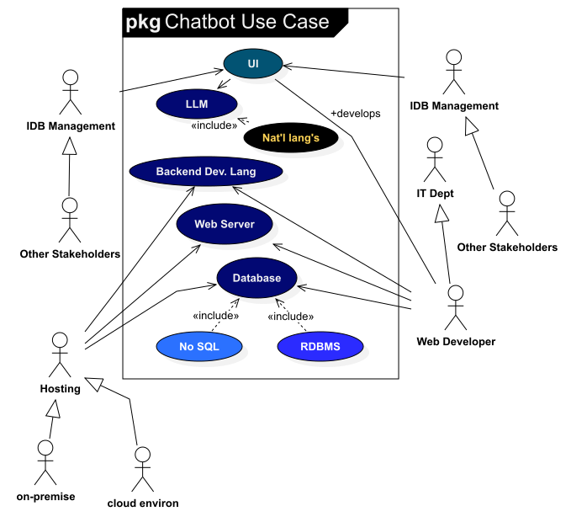
Use case Diagram

Slide 11
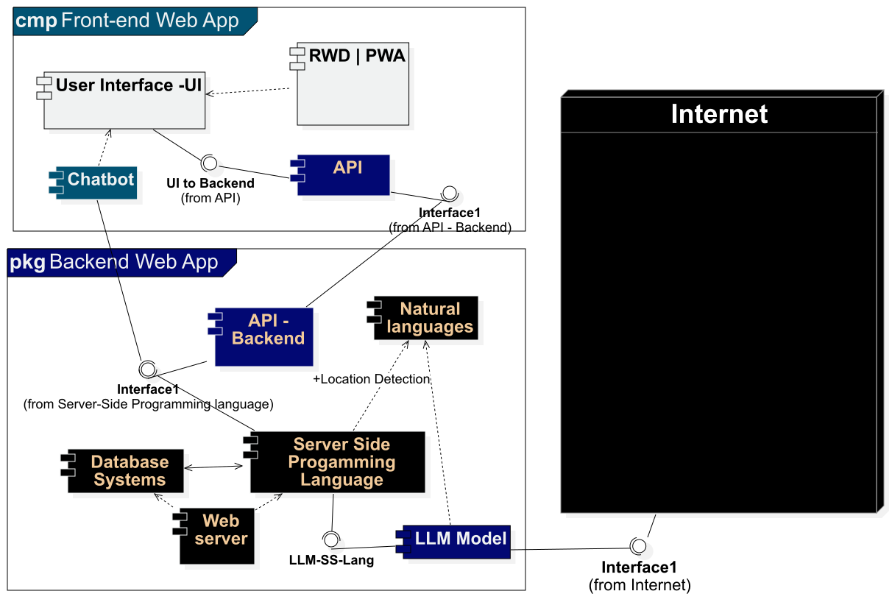
Component Diagram

Slide 12
Component Diagram – Reason for Architecture
UML – a standardized language used by software developers and business professionals for systems development
Standardization – It adheres to a knowledge base that is administered by the Object Management Group (OMG) : https://www.omg.org/spec/UML/
Component Diagram – most suitable as is designed to illustrate the software ‘part’ of a systems and their interdependencies
Bespoke – the solution advocated in the diagram is a customised architecture that adheres to software architecture principle(s) : KISS (Keep It Simple)
KISS principles can be observed in the components of the diagram with intuitive names that will assist developers, and other stakeholders.

Slide 13
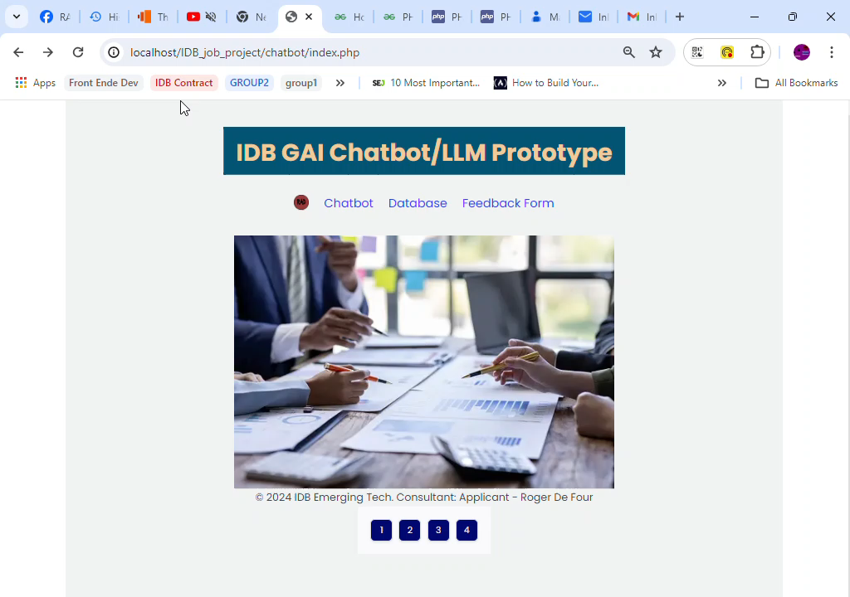

Slide 14
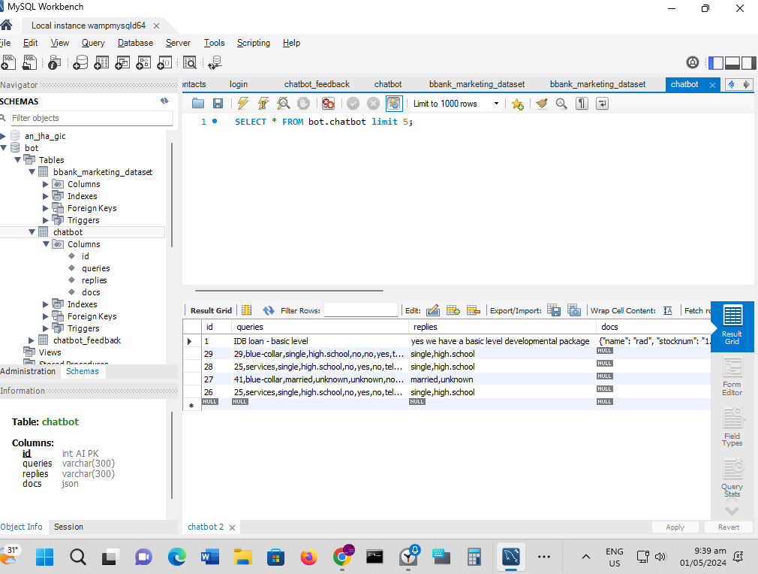
MySQL Backend

Slide 15
Multilingual Chatbot
The chatbot is required to have 3 natural languages. Recommendation: Spanish, French & English.
Selection of Programming languages :
PHP - easiest and most cost effective language to use; frameworks e.g. Laravel and Yii: i18n (internalization) support ;
Python – strong support for AI/ML libraries ;
JAVA – popular and scalable option ;
Clojure – based on the LISP (advanced AI capabilities);
Considerations
Whilst the choice of languages to develop a chatbot are many; the goals of the chatbot is the main deciding factor; the complexity of the Chabot conversations; budget costs; and the development infrastructure available for building the chatbot
Notes:
https://www.computer.org/publications/tech-news/build-your-career/choosing-a-language-for-your-chatbot

Slide 16
Cloud Computing paradigms

Slide 17
CLOUD COMPUTING SERVICE TERMINOLOGIES
IaaS, or infrastructure as a service, is on-demand access to cloud-hosted physical and virtual servers, storage and networking.
PaaS, or platform as a service, is on-demand access to a complete, ready-to-use, cloud-hosted platform for developing, running, maintaining and managing applications.
SaaS, or software as a service, is on-demand access to ready-to-use, cloud-hosted application software.

Slide 18
Key Advantages – Cloud Service offerings
IaaS
Higher Availability – the client organisation can install redundant servers easily, and even disperse them geographically as business needs see fit.
Improved responsiveness – organizations are able to provision(i.e. set aside or create) resources very easily; and generate ideas as business strategies dictate.
SaaS
Easy scalability – easy addition of new users, as per the limitation of the rental agreement
Minimal risk - several SaaS products offer a free trial period, or low monthly fees that allow customers to ‘test drive’ the software and assess, if it will meet their needs, with little or no financial risk.
PaaS
API development and management - With its built-in frameworks, PaaS makes it easier for teams to develop, run, manage and secure APIs for sharing data and functionality between applications
Agile development and DevOps - PaaS solutions typically cover all the requirements of a DevOps toolchain, and provide built-in automation to support continuous integration and continuous delivery (CI/CD).

Slide 19
Key Advantages – Cloud Service offerings
IaaS
Higher Availability – the client organisation can install redundant servers easily.
Improved responsiveness – organizations are able to provision hardware resources quickly.
SaaS
Easy scalability – easy addition of new users.
Minimal risk - several SaaS products offer a free trial period, or low monthly fees.
PaaS
API development and management
Agile development and DevOps – supports DevOps & CI/CD well.

Slide 20
Fine-Tuning Strategy

Slide 21
From research – it has been ascertained that 80% containment rate is the minimum that out project should be aiming for.
Balanced Containment Rate – it is recommended a rate within the range: 70% - 80% threshold for the chatbot app.The 75% success rate reported suggests that the chatbot is operating within acceptable parameters; but does require human intervention from time to time
Recommendations
Increase the number of documents from 5000 to at least 7000 (Reason: brings rate closer to 80%)
Train the LLM model with a larger set of questions, so that the AI model can ‘learn’ and therefore increase the containment rate closer to 80%
Negative feedback – management needs to collate these feedback and take the required corrective action to improve the “bounce rate”.

Slide 22
Conclusion

Slide 23
Proposed Approach - suitability of system architecture
A suitable modelling language UML 2.x.- due to it ease of use by both the IT and business community.
Computing Devices – the web app can facilitate devices with varying screen sizes.
Hosting – traditional web hosting or cloud solutions e.g. AWS or GCP can be used to deploy; using one of the cloud computing services (Iaas, PaaS, or Saas).
PaaS – this is most appropriate as Software Engineers can write custom code and develop web, mobile, PWA or desktop apps.

Slide 24
Potential & Challenges
LLM Chatbots are definitely on the rise, and the way forward, as consumers expect routine business process to be automated, and the turnaround time in problem resolution increases exponentially.
However problems do exist, and the development team in concert with business management needs to take this into consideration.
Problems such as “hallucination” – where the AI systems makes up problem; wrong interpretation of facts ;
LLMs – vastly expensive technologies; missing data

